Slide 1

Queses:
  Array and list representation,
  Operations (traversal, insertion and deletion)
Priority queues and Deques:
  Array and List representations

Slide 2
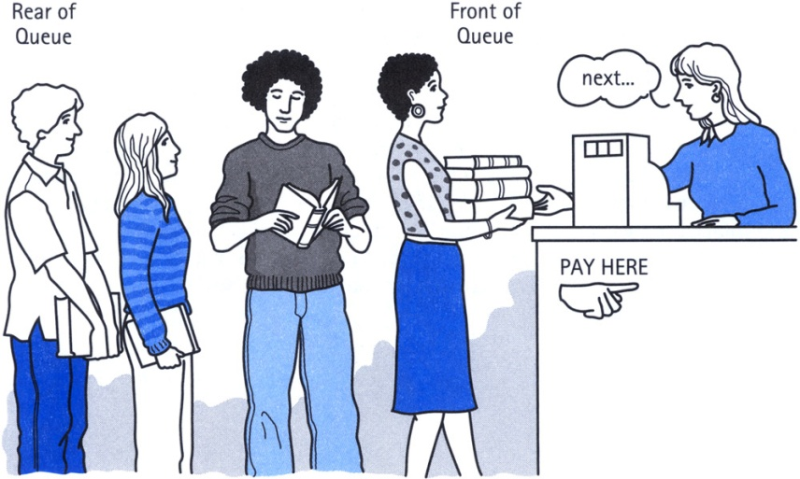
Definition of Queue
A Queue is an ordered collection of items from which items may be deleted at one end (called the front of the queue) and into which items may be inserted at the other end (the rear of the queue).
The first element inserted into the queue is the first element to be removed. For this reason a queue is sometimes called a FIFO (first-in first-out) list as opposed to the stack, which is a LIFO (last-in first-out).

Slide 3
Queue
items[MAXQUEUE-1]
. | .
. | .
. | .
items[2] | C
items[1] | B
items[0] | A
Rear=2
Front=0

Slide 4
Insert an item A
A new item (A) is inserted at the Rear of the queue
items[MAXQUEUE-1]
. | .
. | .
items[3]
items[2]
items[1]
items[0] | A | Front=0, Rear=0

Slide 5
Insert an item B
A new item (B) is inserted at the Rear of the queue
items[MAXQUEUE-1]
. | .
. | .
items[3]
items[2]
items[1] | B | Rear=1
items[0] | A | Front=0

Slide 6
Insert an item C
A new item (C) is inserted at the Rear of the queue
items[MAXQUEUE-1]
. | .
. | .
items[3]
items[2] | C | Rear=2
items[1] | B
items[0] | A | Front=0

Slide 7
Insert an item D
A new item (D) is inserted at the Rear of the queue
items[MAXQUEUE-1]
. | .
. | .
items[3] | D | Rear=3
items[2] | C
items[1] | B
items[0] | A | Front=0

Slide 8
Insert Operation(Array)
QINSERT(QUEUE, N, FRONT, REAR, ITEM)
If FRONT = 1 and REAR = N, or FRONT = REAR + 1, then :
write OVERFLOW, and Return.
2. If FRONT = NULL, then:
Set FRONT := 1 and REAR := 1.
Else if REAR = N, then:
Set REAR := 1.
Else :
Set REAR := REAR + 1.
3. Set QUEUE[REAR]:= ITEM.
4. Return.

Slide 9
Delete A
An item (A) is deleted from the Front of the queue
items[MAXQUEUE-1]
. | .
. | .
items[3] | D | Rear=3
items[2] | C
items[1] | B | Front=1
items[0] | A

Slide 10

Delete B
An item (B) is deleted from the Front of the queue.
items[MAXQUEUE-1]
. | .
. | .
items[3] | D | Rear=3
items[2] | C | Front=2
items[1] | B
items[0] | A

Slide 11
Delete C
An item (C) is deleted from the Front of the queue
items[MAXQUEUE-1]
. | .
. | .
items[3] | D | Front=Rear=3
items[2] | C
items[1] | B
items[0] | A

Slide 12
Delete D
An item (A) is deleted from the Front of the queue.
items[MAXQUEUE-1]
. | .
items[3] | D | Front=Rear=-1
items[2] | C
items[1] | B
items[0] | A

Slide 13
Delete Operation(Array)
QDELETE(QUEUE, N, FRONT, REAR, ITEM)
If FRONT = NULL then :
write: UNDERFLOW, and Return.
2. Set ITEM := QUEUE[FRONT].
3. If FRONT = REAR,
Set FRONT := NULL and REAR := NULL
Else if FRONT = N, then:
Set FRONT := 1.
Else :
Set FRONT := FRONT + 1.
4. Return.

Slide 14
Insert Operation(LL)
LINKQ_INSERT(INFO, LINK, FRONT, REAR, AVAIL, ITEM)
If AVAIL = NULL, then :
write OVERFLOW, and Exit.
2. Set NEW := AVAIL and AVAIL := LINK[AVAIL]
3. Set INFO[NEW]:= ITEM and LINK[NEW]=NULL
4. If (FRONT = NULL), FRONT := REAR := NEW
Else set LINK[REAR] := NEW and REAR := NEW
5. Exit

Slide 15
Delete Operation(LL)
LINKQ_DELETE(INFO, LINK, FRONT, REAR, AVAIL, ITEM)
If FRONT = NULL, then :
write UNDERFLOW, and Exit.
2. Set TEMP := FRONT
3. Set ITEM :=INFO[TEMP]
4. FRONT :=LINK[TEMP]
5. LINK[TEMP] = AVAIL and AVAIL = TEMP
6. Exit

Slide 16
Priority Queue
More specialized data structure.
Similar to Queue, having front and rear.
Items are removed from the front.
Items are ordered by key value so that the item with the lowest key (or highest) is always at the front.
Items are inserted in proper position to maintain the order.

Slide 17
Deques
It is a double-ended queue.
Items can be inserted and deleted from either ends.
More versatile data structure than stack or queue.
E.g. policy-based application (e.g. low priority go to the end, high go to the front)

Slide 18
Thank You

